Slide 1
Pharmaceutical Grade Synthetic Cannabidiol Overview: 294 cases with late-stage cancer, treated over a 4 year period
The Dove Clinic for Integrated Medicine – May 2018

Slide 2
Dr Julian Kenyon Medical Director The Dove Clinic for Integrated Medicine Winchester and London www.doveclinic.com

Slide 3
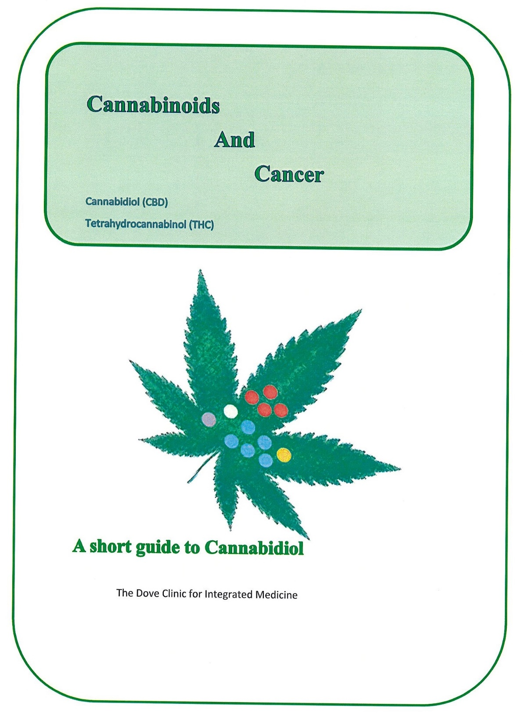

Slide 6
Cannabidiol is both a Chemosensitiser and a Radiosensitiser and therefore both of these treatments will work more effectively when using Cannabidiol and the side effects will be less.
CBD and THC
THC potentiates CBD, but only tiny amounts are needed. This principally applies to cases of Brain Tumours. However, the majority of patients are best served by using CBD alone.
Side effects
We have not come across any side effects of Cannabidiol, even at very high doses, therefore we have been unable to define a maximum tolerated dose. This speaks a lot for the safety of this approach.
In our experience, Cannabidiol needs to be taken for a minimum of six months.
Legal ‘Umbrella’
The legal ‘Umbrella’ for the use of Cannabidiol is the Pharmaceutical Specials scheme, which is administered by the Medicines and Health Regulatory Agency.

Slide 7
Definition of Cannabidiol (CBD)
We are able to prescribe Cannabidiol (CBD) under the ‘Specials Pharmaceutical Scheme’ as regulated by the MHRA (Medicines Health Regulatory Association) on an informed consent, named patient basis under the guidance and supervision of a trained Medical Doctor.
This is a synthetic copy of the Cannabidiol molecule found in cannabis. It is only possible to produce concentrate from the cannabis plant at 5% or thereabouts. Making it synthetically we can get 100% preparation at 100% concentration and this is very important in terms of clinical effect. This enables us to prescribe this legally.
The dose of CBD is variable, according to the staging and type of disease being treated. It is generally given on a pulsed basis – 3 days on, 3 days off because this is found to be more effective than a continuous dosage regime.
When extracted from the plant, Cannabis Oil concentrates are contaminated with a whole range of cannabinoids, and they mostly average between 0.5% to a high of 2.6% of Cannabidiol concentration.
http://www.fda.gov/newsevents/publichealthfocus/ucm435591.htm
Continued..

Slide 8
Definition of Cannabidiol (CBD) cont..
We use synthetic Pharmaceutical Grade Cannabidiol in oily drops 5% w/v in 20 ml bottles. This bottle contains 730 drops.
Each drop contains 1 mg of synthetic Pharmaceutical Grade Cannabidiol in neutral oil.
40% of our patients who are now on Pharmaceutical Grade Synthetic Cannabidiol had previously been taking Cannabis Oil obtained over the Internet, with no response.

Slide 9
Cannabidiol and Cancer
Cannabidiol in cancer has a dose-response relationship and, as it is completely free of side effects, doses many times higher than the standard recommended dose are tolerated.
In cancer we use a pulsed regime – 3 days on, 3 days off. This is significantly more effective than a continuous dosage, and is based on homeostatic immune oscillations in cancer patients.
Of the 294 cases, 113 were assessable for various reasons.
That is because many of the late-stage cancer patients only come to see us once and then we lose contact with them and any case where the use of Cannabidiol does not extend beyond three months is not assessable.
Also there is a significant cohort of cases who have yet to reach six months to become assessable.

Slide 10
CBD in Cancer - Assessable Cases *all cases who died also had extended median survival
Cancer Type | Tumour Free | Stable Disease | Extended Median Survival | Slowed Progression | No effect or result | Died | Lost to follow up Ass/ble cases | CBD as Only Treatment | Unknown Outcome |  | (total cases)
Anaplastic Ependymoma |  |  | 3 |  |  |  |  | 3 |  |  | 3
DIPG |  |  | 1 |  |  |  |  | 1 |  |  | 1
Glioblastoma Multiforme |  |  | 4 | 3 |  | 3 |  | 4 |  |  | 7
Bladder Cancer |  | 1 | 1 |  |  |  |  |  |  |  | 2
Breast Cancer | 7 | 21 | 8 |  | 3 | 6 |  | 6 |  |  | 39
Head and Neck Cancer | 1 |  |  | 1 |  |  |  |  |  |  | 2
Prostate Cancer |  | 10 | 3 |  |  | 3 |  | 6 |  |  | 16
Neuroendocrine Tumour |  | 1 |  |  |  |  |  |  |  |  | 1
Non Hodgkin's Lymphoma | 1 | 6 |  |  |  | 1 |  | 3 |  |  | 8
Non Small Cell Lung Cancer |  |  | 2 |  |  | 2 |  | 2 |  |  | 2
Colorectal Cancer | 1 |  | 9 | 2 | 1 | 6 |  |  |  |  | 13
Pancreatic Cancer |  |  | 2 |  |  | 2 |  | 2 |  |  | 4
Ovarian Cancer |  |  | 5 | 1 |  | 3 |  | 1 |  |  | 6
Miscellaneous | 2 | 6 | 5 | 1 | 1 | 1 |  |  | 1 |  | 15
Totals | 12 | 45 | 43 | 8 | 5 | 27 | 0 | 28 | 1 |  | 119

Slide 11
Cannabidiol in Cancer has a
dose-response relationship and as it is completely free of side effects, doses many times higher than the standard recommended dose are tolerated.

Slide 12
In Cancer we use a pulsed regime – 3 days on, 3 days off.
This is significantly more effective than a continuous dosage, and is based on homeostatic immune oscillations in Cancer patients.

Slide 13
Of the 294 cases, 113 were assessable for various reasons.
That is because many of the late-stage Cancer patients only come to see us once and then we lost contact with them and any case where the use of Cannabidiol does not extend beyond three months is not assessable.
Also, there is a significant cohort of cases who have yet to reach six months and become assessable.

Slide 14
The following slides show a selection of particular cases with Pharmaceutical Grade Synthetic Cannabidiol as the only treatment

Slide 15
Case 1 - (M) Aged 72 (Ref 6167)
This patient has Prostate Cancer which was diagnosed in August 2013 - some of the tumour was Gleason 9, some of it was Gleason 7. He refused all standard treatments.
He had been receiving Testosterone Injections for some years, to improve his libido and from that point of view the Testosterone was successful. He had a Cancer Immunotherapy in April 2014 (Sono and Photodynamic Therapy). Following the Cancer Immunotherapy (SPDT), his PSA dropped to 0.82.
He then resumed his Testosterone Injections from his private Dr. and his PSA rose up to high levels. We advised him to stop the Testosterone Injections.
We started him on Cannabidiol early in 2015 at a dose of 10 drops twice a day, three days on and three days off. We followed his progress with a Circulating Tumour Cells test (CTC) and we were able to show reduction in CTCs with the Cannabidiol alone, and no other treatment, from in the first place over 8.1 cells per 7.5ml down to 5.9 cells on a subsequent test.
Subsequent tests showed a drop to 4.8 cells and then to 4.2 cells. The next test showed 3.2 cells. He then decided to reduce his dose of Cannabidiol and his Circulating Tumour Cell level went up on his next test to 5.9 cells. This shows a clear dose/response relationship. He is still under treatment. CBD has been the only treatment since 2014.

Slide 16
Case 2 - (M) Aged 5 – Ref 7578
This patient has Anaplastic Ependymoma with progressive disease.
This patient had all standard treatments and no further treatment options were available to him when we started treating him.
We started him on Cannabidiol in February 2016. A scan carried out in December 2016 showed tumour volume had decreased by 2/3.
Further scans carried out since December 2016 continue to show stable disease.
CBD has been the only treatment.

Slide 17
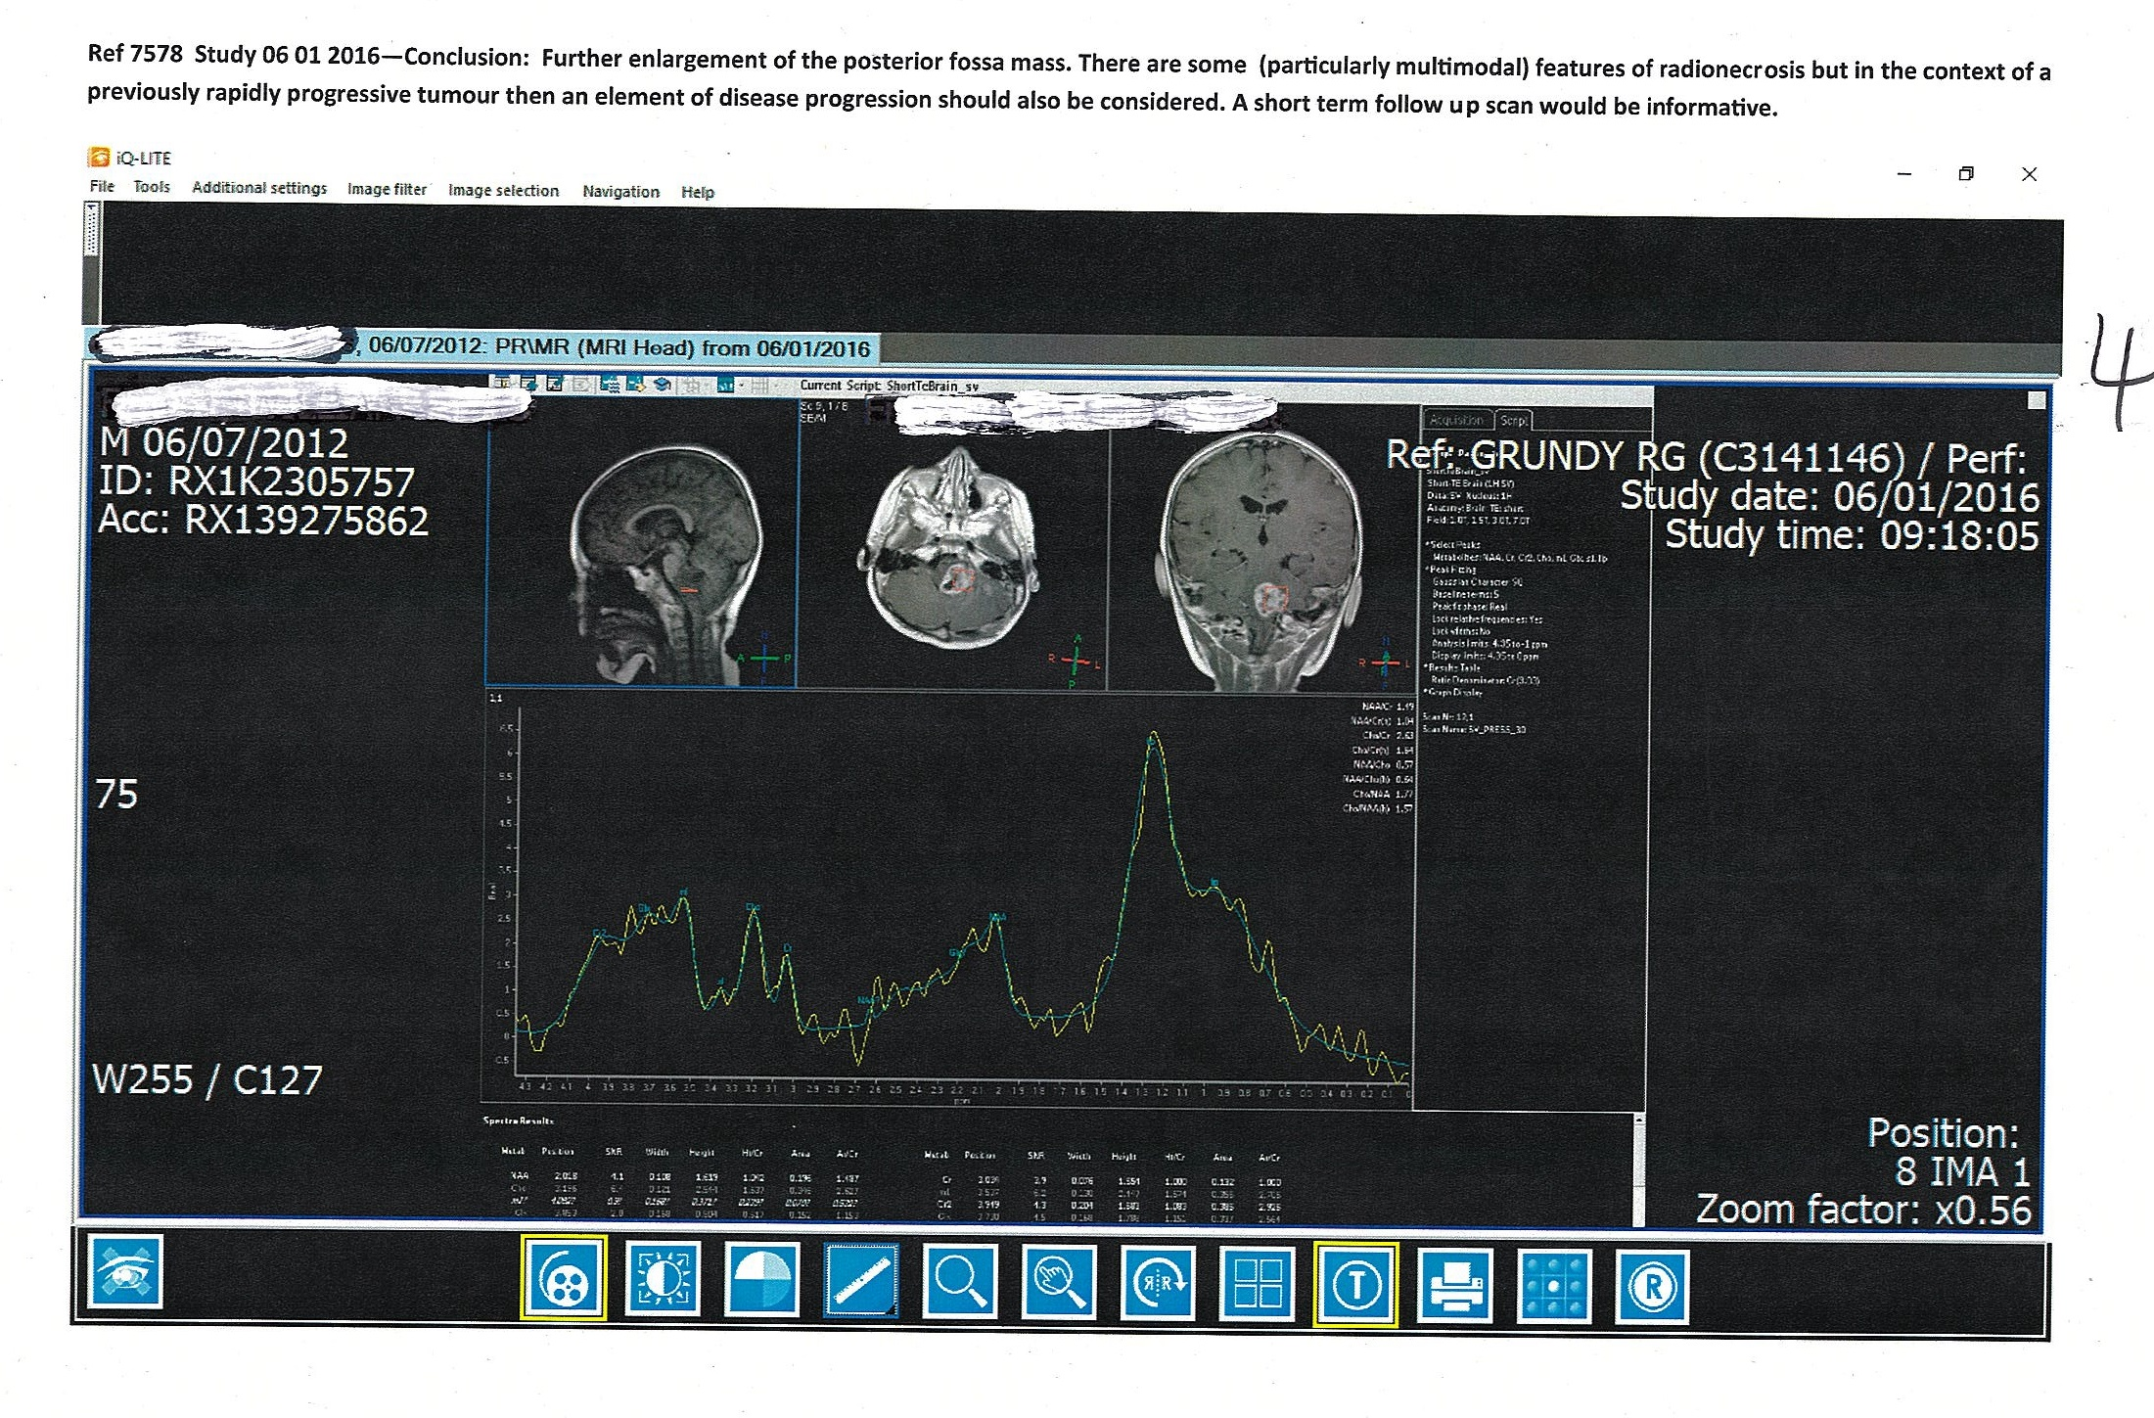

Slide 18
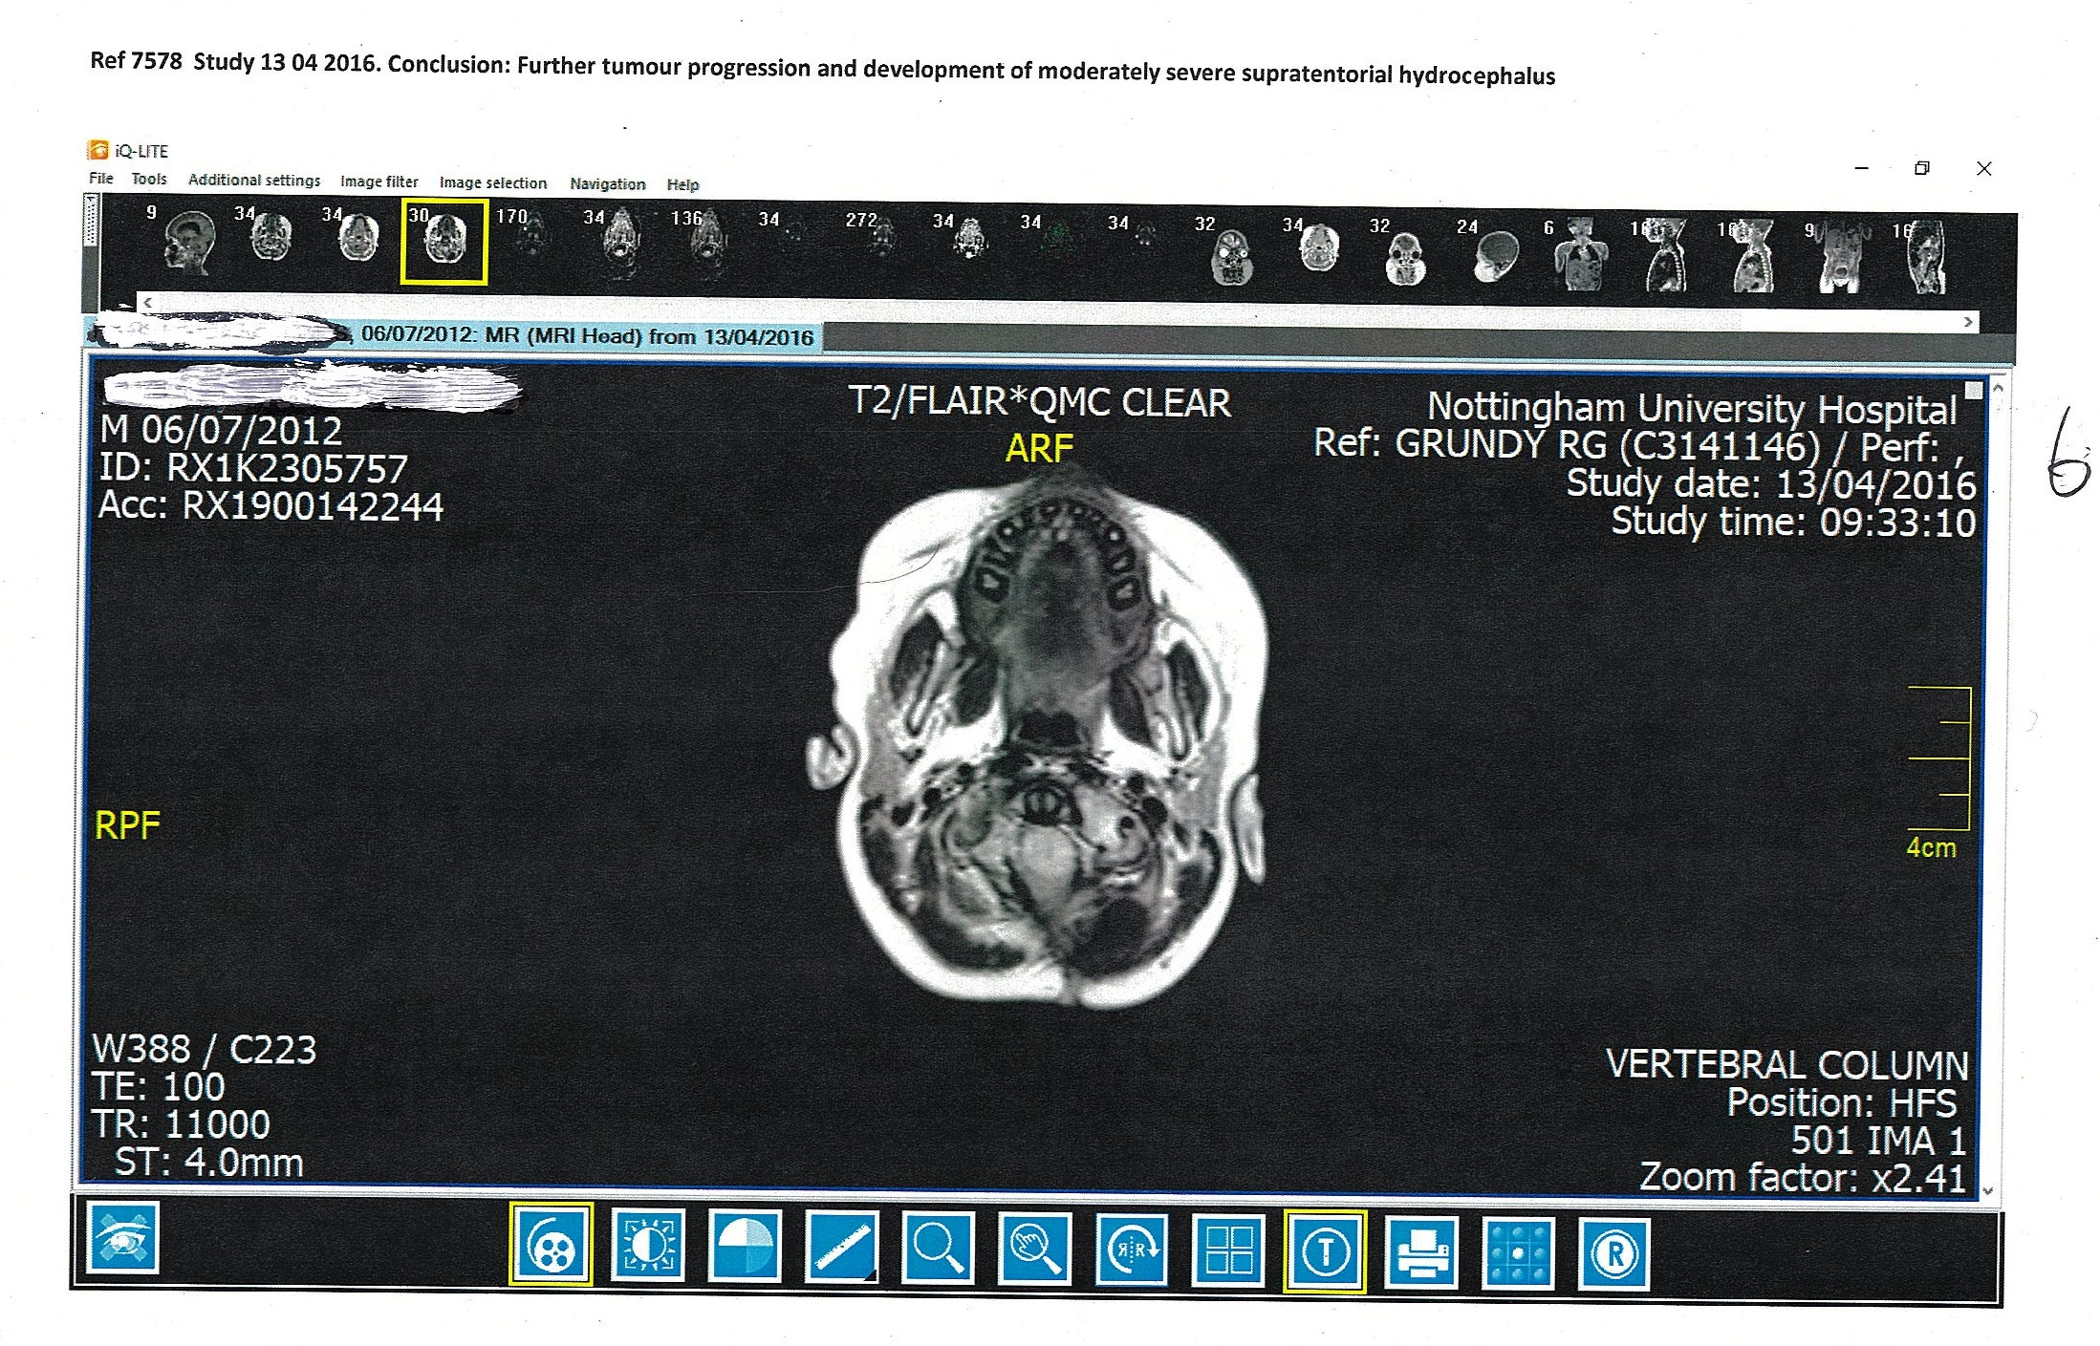

Slide 19
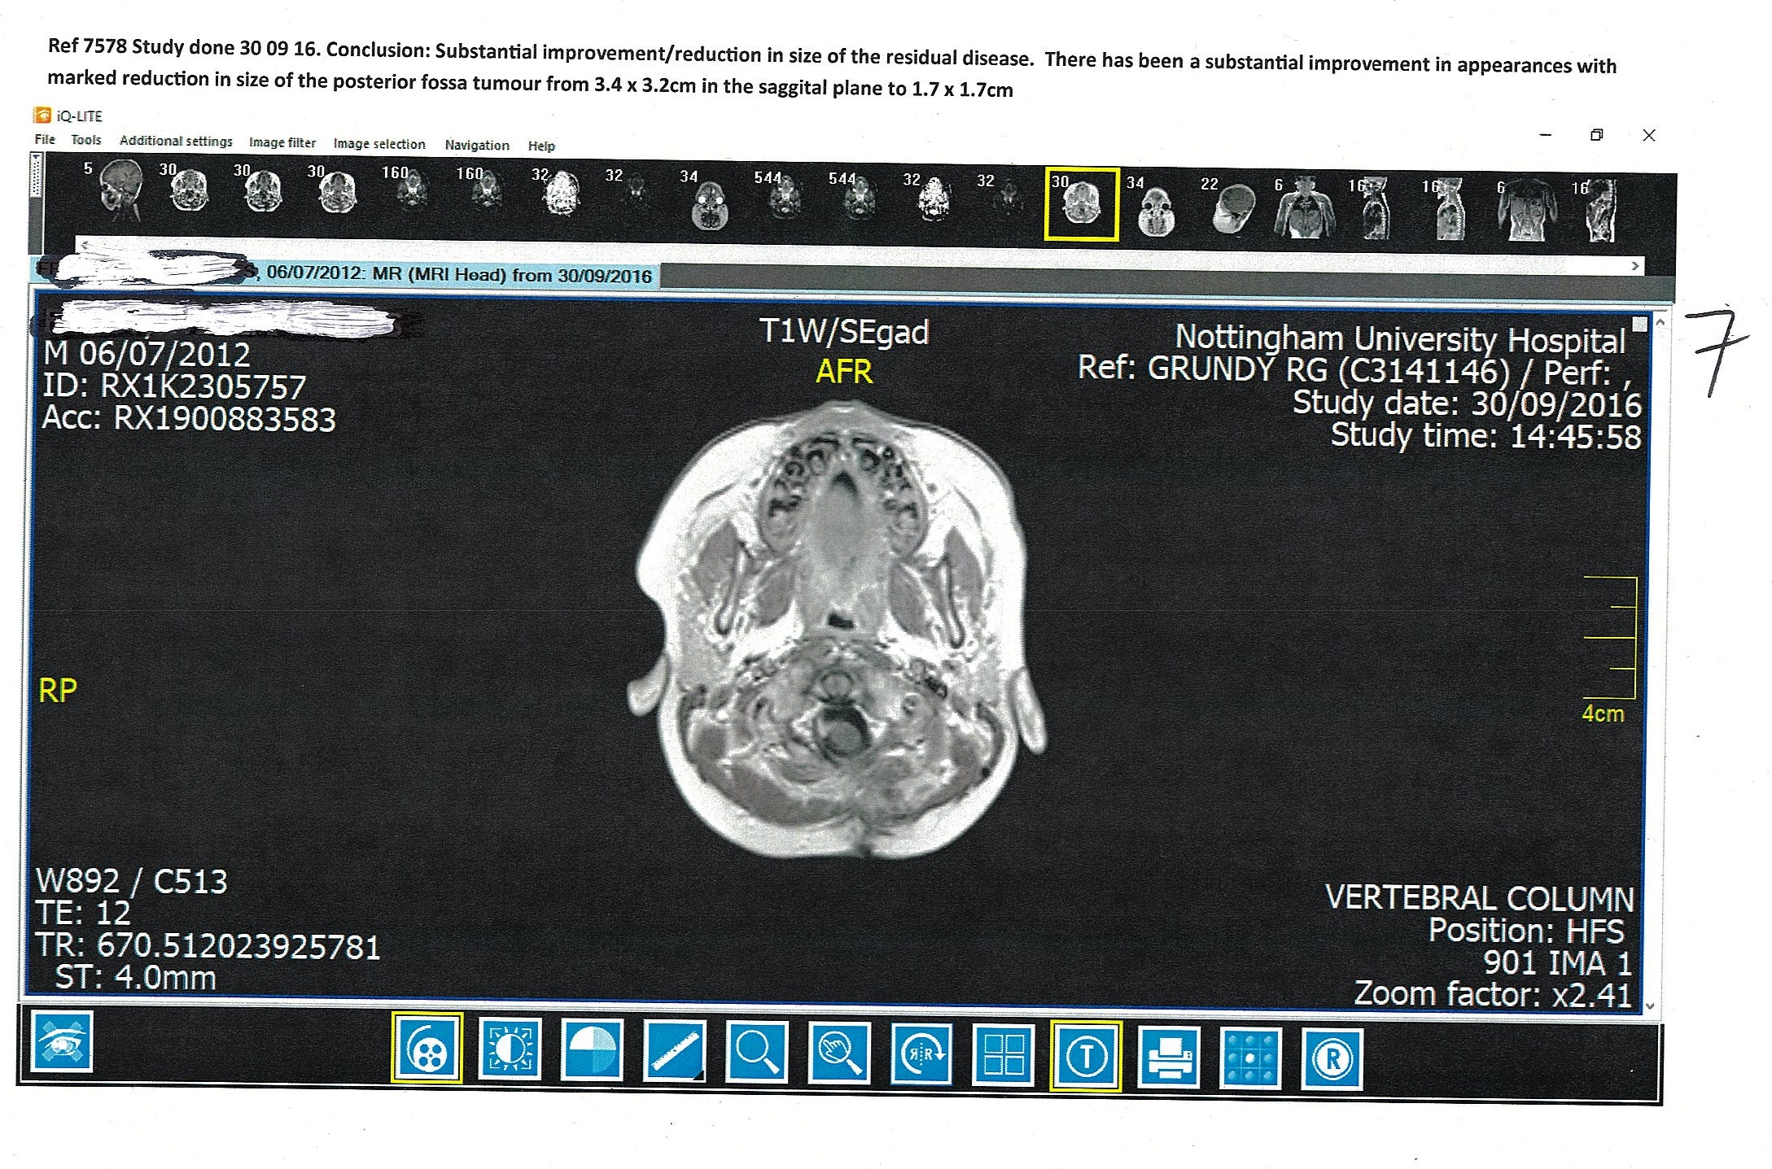

Slide 20
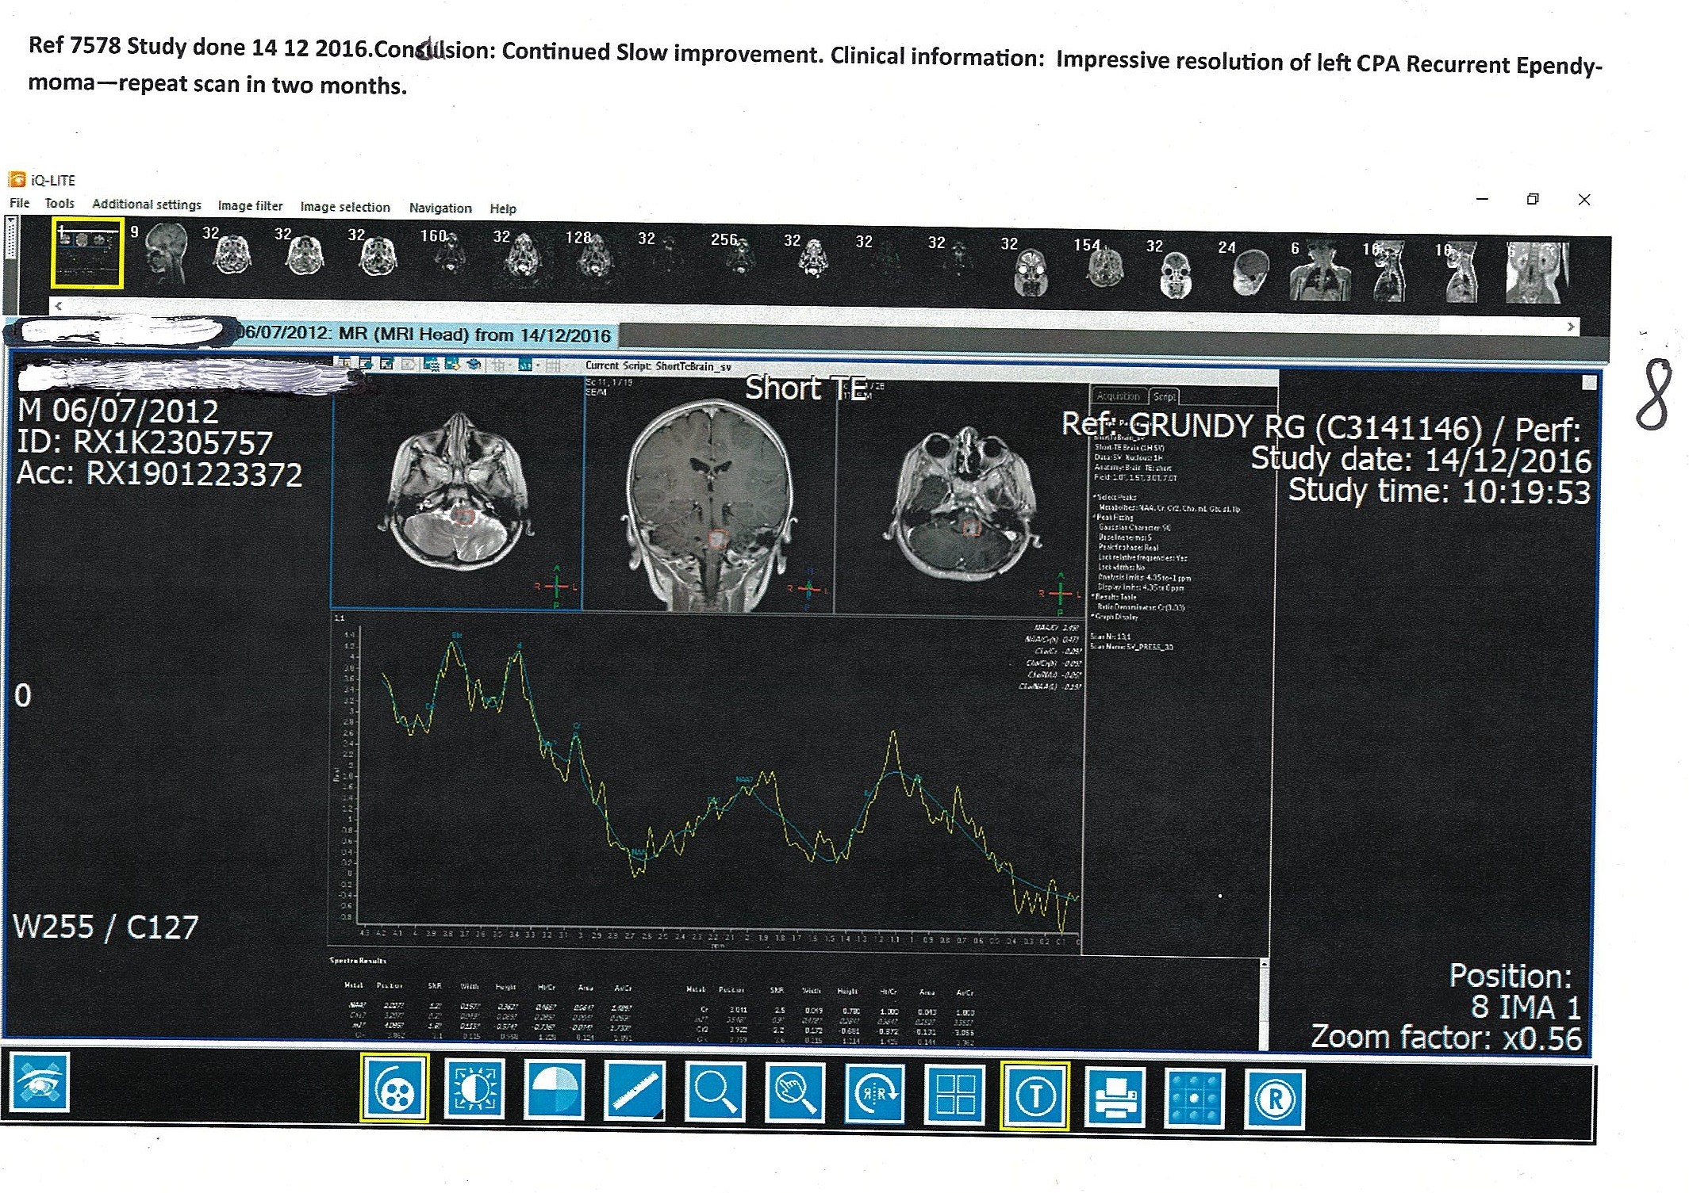

Slide 21
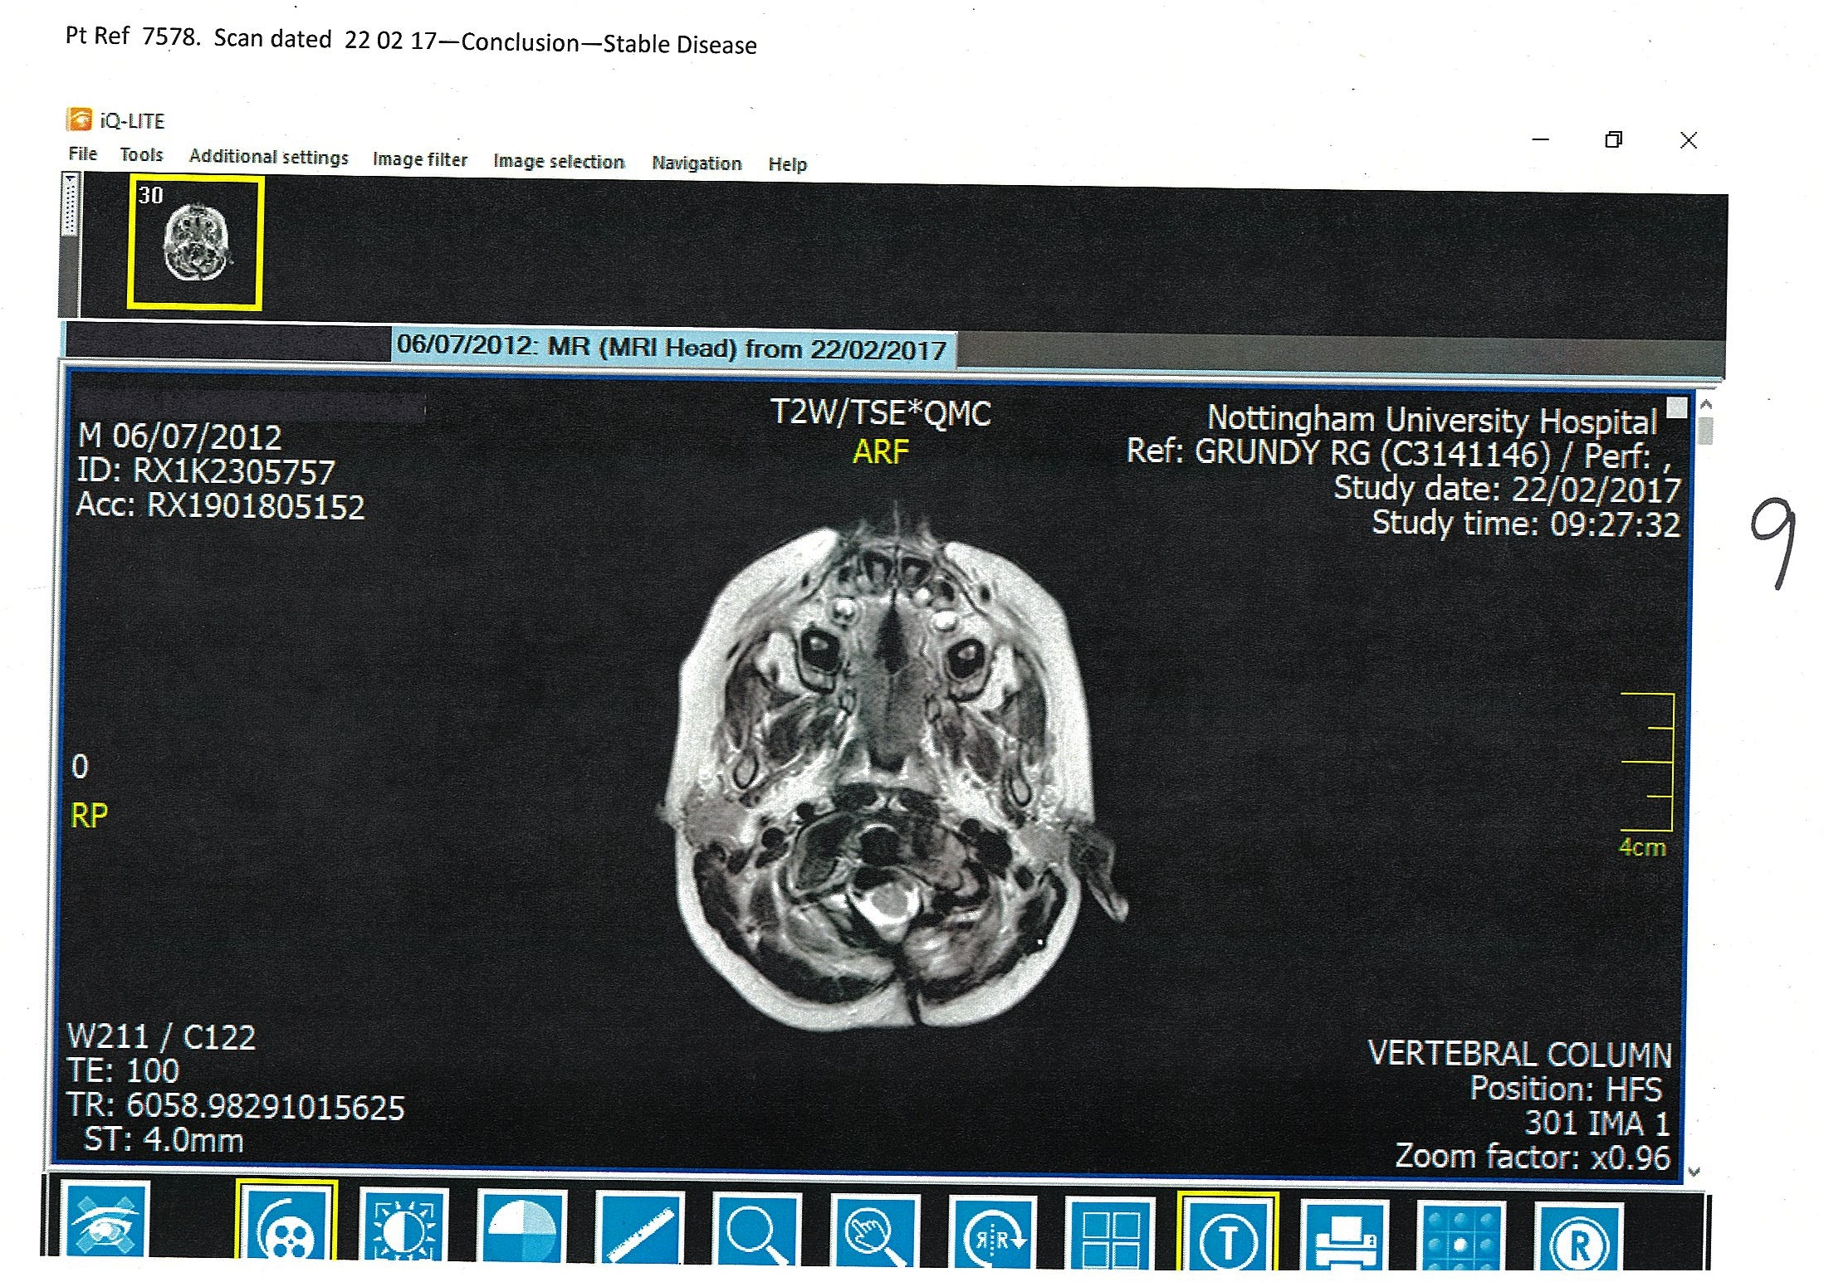

Slide 22
Case 3 – (F) Aged 68 – Ref 0381
This patient has Metastatic Breast Cancer with bone metastases, diagnosed in March 2014, which showed on CT Scan as being progressive disease.
She started local Radiotherapy. We started her on Cannabidiol in January 2015, all subsequent scans have shown stable disease. She has had no treatment other than Cannabidiol following her Radiotherapy.

Slide 23
Case 4 – (M) Aged 81 – Ref 6684
This patient has Gleason 8 Prostate Cancer, diagnosed in 2004. All standard treatments were rejected. We saw him in July 2014 with a rising PSA, which had risen to 35.
We started him on Pharmaceutical Grade Cannabidiol in April 2015 with no other treatment. In July 2015 his PSA had dropped to 24.3. In September 2015 it was 24.6. At that point he decided to reduce the dose of his Pharmaceutical Grade Cannabidiol and in June 2016 his PSA had risen to 28.
In December 2016 his PSA was 29, in March 2017 it was 30. At that time he decided to switch to Cannabis Oil bought over the Internet. His next PSA in September 2016 showed an increase to 35. This further increased in March 2018 to 42. He continues on Cannabis Oil obtained on the Internet.

Slide 24
Case 5 (F) Aged 65 - Ref 8177
This patient was diagnosed with Oesophageal Cancer in May 2016.
She had a stent put in place at that time and she was given an expected survival of three months. This patient was a Jehovah’s Witness and refused all standard treatment.
Since then, she has been on Cannabidiol as the only treatment and she has continued to refuse all standard treatments and investigations.
We last saw her in November 2016, when she was looking well and had regained weight. She died in January 2018.

Slide 25
Case 6 - (F) Aged 65 6715
Left sided Breast Cancer diagnosed in November 2009. This patient refused all conventional treatment and all investigations.
On examination she had a large fungating lesion 15cm in diameter in the left breast and also palpable left axillary nodes.
We started treating her with Synthetic Cannabidiol in October 2014. We persuaded her to have Radiotherapy in November 2014. She only agreed to having half the recommended treatment course.
She has continued on Cannabidiol alone and on her last appointment the tumour in her left breast was 2cm in diameter, with no palpable axillary nodes.
The measurements in this case are exact. She refused having her tumour photographed.
Circulating Tumour Cell test was done in October 2017 and this showed she had 3.4 cells per 7.5ml. Currently, therefore, she has stable disease.

Slide 26
Case 7 – (F) Aged 67 Ref 6470
This patient was diagnosed in October 2012 with Right Sided Lobular Breast Cancer, 8cm long, multicentric and metastasised into lymph glands in the right axilla. Oestrogen negative, Progesterone negative, HER2 positive.
She refused standard methods of treatment because she reacted in a life-threatening way to Chemotherapy and then refused all further treatment.
We gave her High Dose Intravenous Vitamin C in October 2014. Since that time, she has been on Pharmaceutical Grade Synthetic Cannabidiol as the only method of treatment.
Circulating Tumour Cells test done in October 2014 showed 9.3 cells per 7.5ml. In September 2015 this showed 7.5 cells per 7.5ml, a further test done in March 2016 showed 6.8 cells per 7.5ml and the last test, done in March 2017, showed 2 cells per 7.5ml.
All standard clinical investigations and scans have been normal since the beginning of 2015.
She has had a recent scan on the 5th February 2018 and this shows no evidence of any disease.

Slide 27
Case 8 (F) Aged 62 Ref 6583
This patient had Breast Cancer diagnosed in 2006, she had a Mastectomy, Axillary Node Clearance Oestrogen Receptor and Progesterone Positive, HER2 Negative . She was put on tamoxifen for five years.
She had a left-sided interpectoral mass lesion diagnosed on a PET CT in February 2013. Also, multiple intrapulmonary nodules, varying in size up to 12mm seen in both lungs. We carried out Cancer Immunotherapy (SPDT) in September 2014. She had a PET CT Scan in September 2014 and this showed progression in her lung metastases, including right hylar nodal involvement. She then refused further scans.
She has been on Pharmaceutical Grade Synthetic Cannabidiol as the only treatment since October 2014.
She only agreed to be monitored by Circulating Tumour Cells tests and refused all further scans. The Circulating Tumour Cells test showed a consistent drop in the number of circulating tumour cells per 7.5ml. Currently, she remains stable with no symptoms.

Slide 28
Case 9 – (M) Aged 50 – Ref 7797
This patient had a progressive Tanycytic Ependymoma Grade 2 diagnosed in June 2013, treated with Biopsy and Radical Radiotherapy, which was completed on 3rd June 2015.
He was diagnosed with progressive disease in June 2016. He started on Pharmaceutical Grade Synthetic Cannabidiol in July 2016 at a dose of 10 drops twice a day, three days on and three days off. Prior to this he had been taking, for some time, Metformin, Mebendazole, Doxycycline and Atorvastatin from an Oncology Clinic in Central London.
In January 2017 a repeat scan showed tumour reduction. At that point the patient stopped taking Pharmaceutical Grade Synthetic Cannabidiol and switched to Cannabis Oil extract obtained from an Internet site.
Further scan carried out in March 2018 showed doubling of tumour size and more growth down the brain stem. He has since restarted Pharmaceutical Grade Synthetic Cannabidiol and throughout has continued to take the Metformin, Atorvastatin, Doxycycline and Mebendazole.
So, the only change in November 2017 was stopping the Pharmaceutical Grade Synthetic Cannabidiol and switching to Cannabis Oil Extract obtained on the Internet.

Slide 29
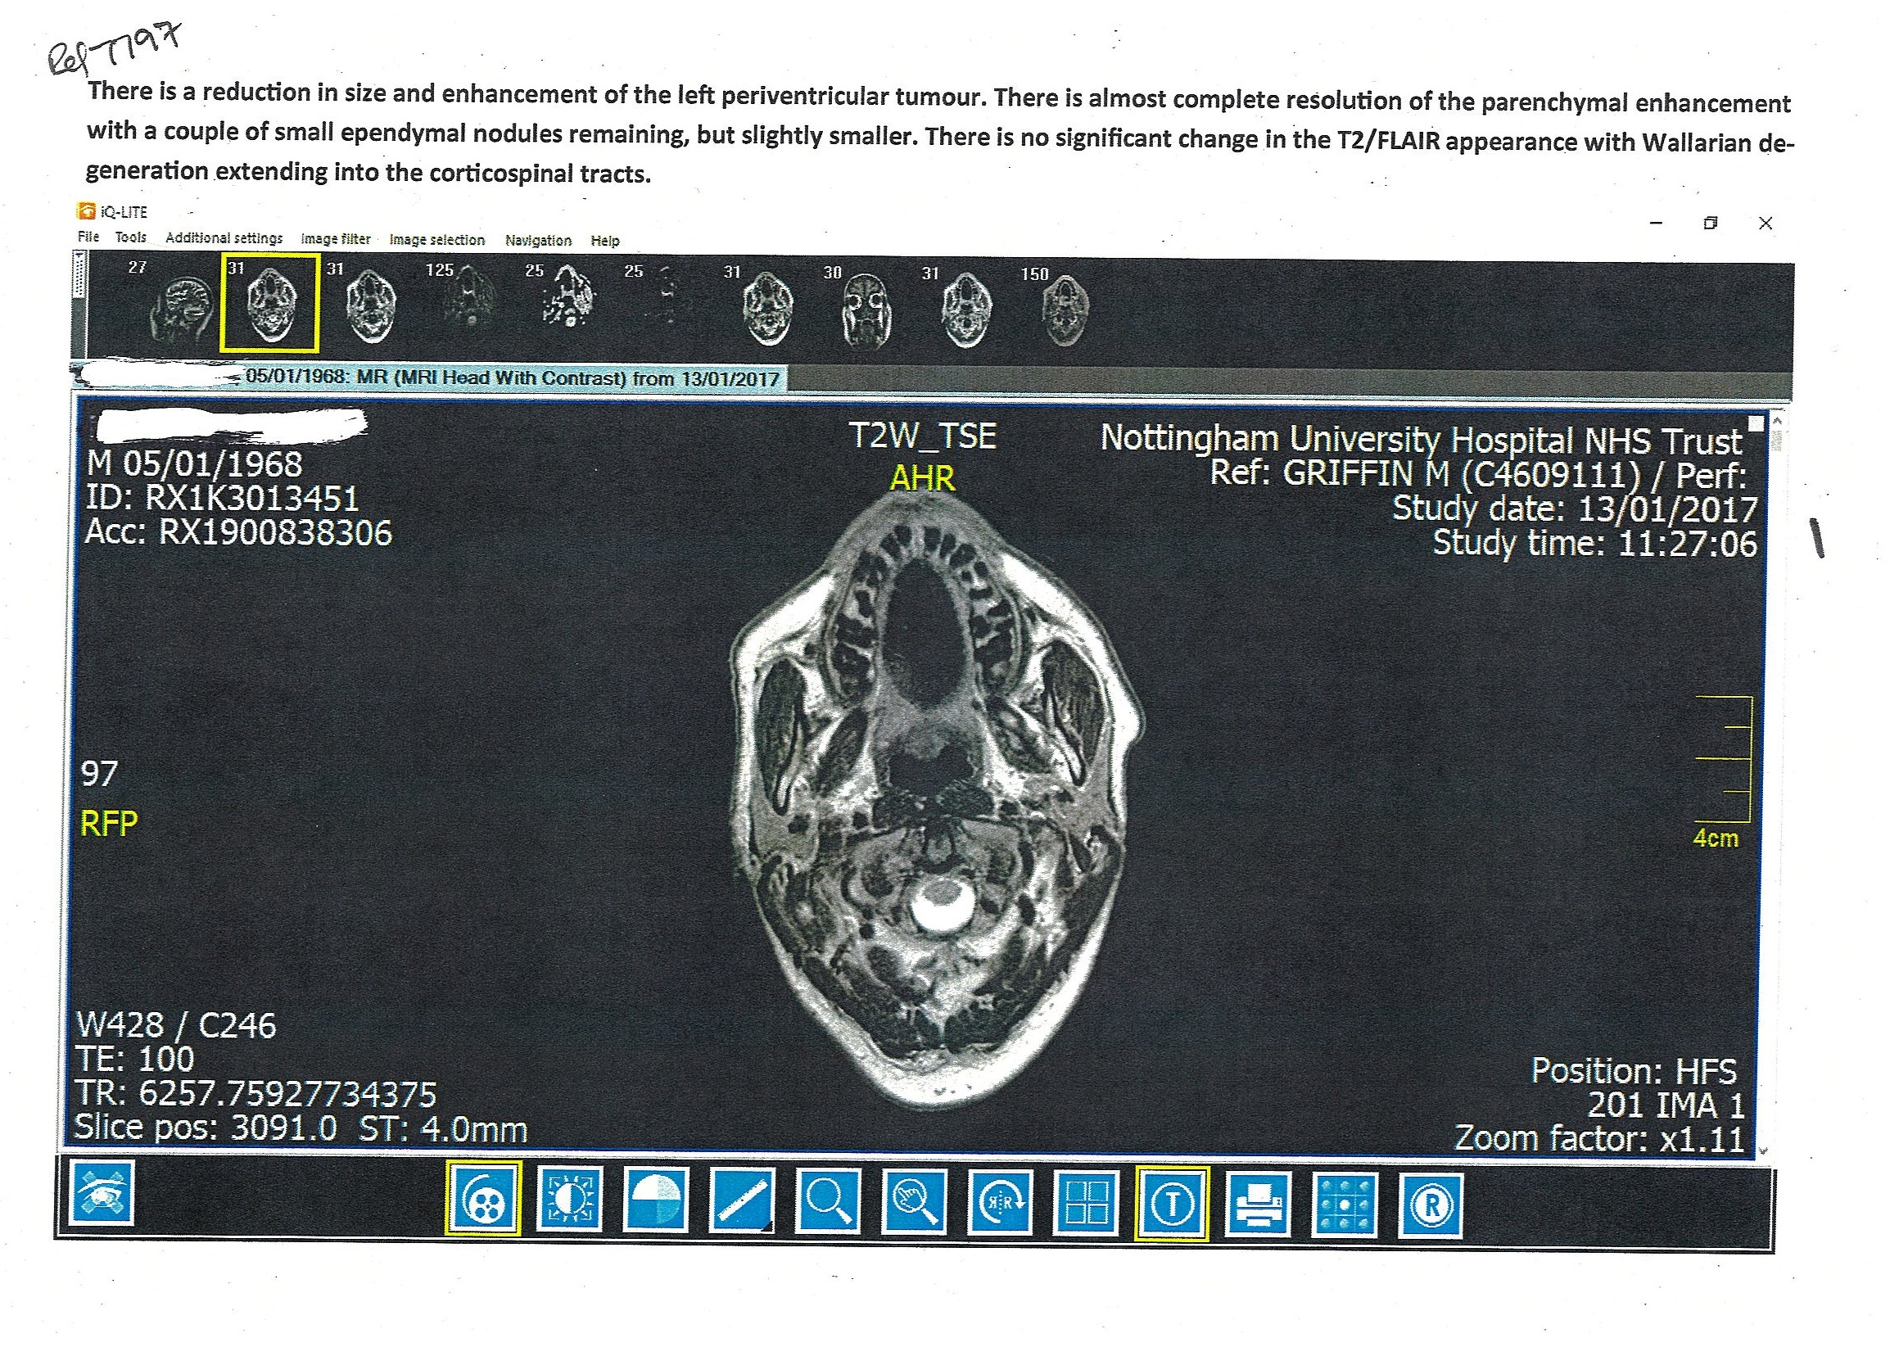

Slide 30
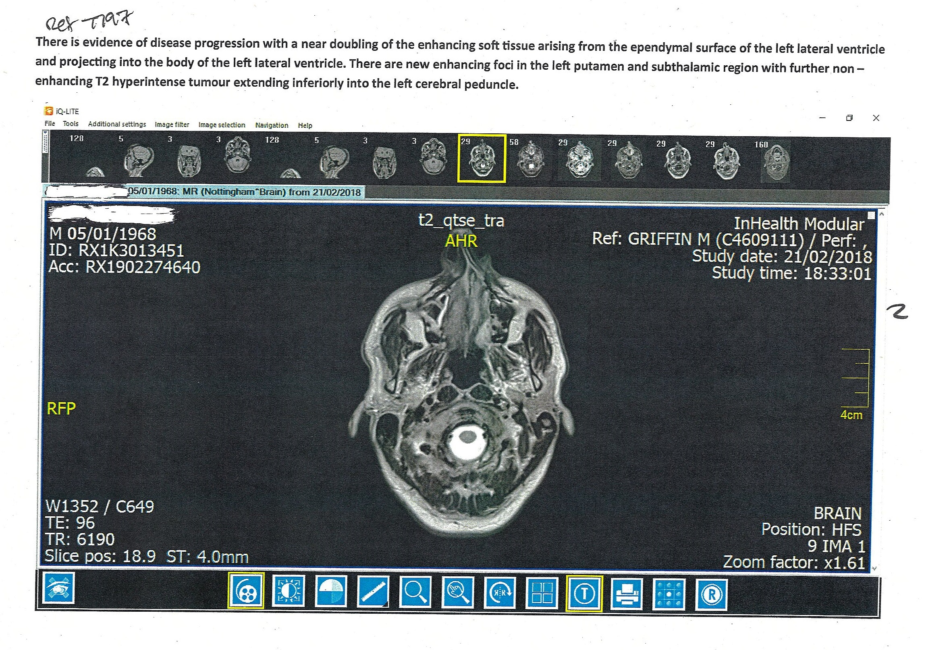

Slide 31
Conclusion
Pharmaceutical Grade Synthetic Cannabidiol is safe, even at large doses. It has potential in a wide range of uses and needs to gain more recognition.
It is no surprise that Cannabidiol has been used for centuries for recreation purposes, but also for medicinal purposes, so therefore, if for nothing else this has been used for health benefits, but clearly the THC content is addictive and is certainly dangerous for the developing brain in teenagers, increases the risk of psychotic illness, and indeed, a range of psychiatric conditions.

Slide 32
Pharmaceutical Grade Synthetic Cannabidiol can be prescribed by any Doctor.
Any Doctor interested should make contact with
Dr Julian Kenyon via
secretaries@doveclinic.com

