Slide 1


Viscum Album Extract (Mistletoe): Complimentary to and Enhancing of the LDN Effect
Dr. Nasha Winters, ND, FABNO
www.Terrain10.com
Glasgow, Scotland LDN Conference, July 2018
Copyright © 2018 Optimal Terrain Consulting. All Rights Reserved.

Slide 2

DISCLAIMER
All information shared is for educational purposes only. NO part of this presentation may be copied or shared with others. This is copy righted material.
I have no financial disclosures
Copyright © 2018 Optimal Terrain Consulting. All Rights Reserved.

Slide 3
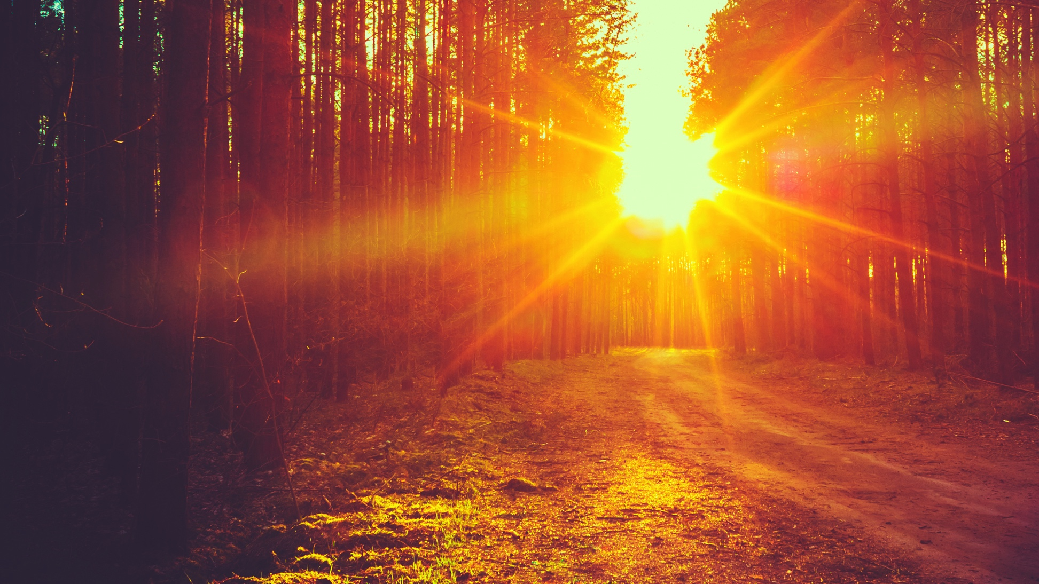
“More information is always better than less. When people know the reason things are happening, even if it's bad news, they can adjust their expectations and react accordingly. Keeping people in the dark only serves to stir negative emotions.”
- SIMON SINEK
Copyright © 2018 Optimal Terrain Consulting. All Rights Reserved.

Slide 4


40%
300%
increase since the 1970’s on secondary cancers (likely thanks to initial treatment)
70%
of all women between 40-50 years old have microscopic breast tumors
chance of recurrence after initial diagnosis
1IN 2
MEN
1IN 2.4
WOMEN
50%
will have cancer in their lifetime
of all men 50-60 years old have microscopic prostate
tumors
1 IN 8
100%
of of people over 70 years have microscopic thyroid cancer
US women will have breast cancer
Copyright © 2018 Optimal Terrain Consulting. All Rights Reserved.
Notes:
Fastest growing rate of cancer is GBM/brain in 24 and younger, resurgence of lymphoma/leukemia in peds again and fastest growing CRC in folks under 35.
1/2 with DM
Number one disease to take over US: neurological (Alzheimer’s/ Autism/ ADD/ADHD/Dementia, Demylenating disorders, etc
Globesity/Diabesity, endocrine disruptors such as plastics and glyphosate, fertility issues, etc.
Normal cells double every 3 days, cancer cells double every 9 hours---where does the signaling pathway go awry? Can take 5-10 years to be clinically detectable---plenty of time to turn the boat around in the harbor
BioCept testing to KNOW what is up

Slide 5

“ONE CAN ASCEND TO A HIGHER DEVELOPMENT ONLY BY BRINGING RHYTHM AND REPETITION INTO ONE’S LIFE. RHYTHM HOLDS SWAY IN ALL NATURE.”
- RUDOLF STEINER
Copyright © 2018 Optimal Terrain Consulting. All Rights Reserved.

Slide 6
Mitochondrial Mayhem
Copyright © 2018 Optimal Terrain Consulting. All Rights Reserved.
Notes:
Determinants of health:
Breath, fresh air
• Clean water and hydration
• Sleep (normal biorhythms)
• Nutrition and digestion
• Rest and recreation
• Light (vit. D)
• Cycles: solar, lunar, lifecycles
• Environment, geography
• Exposure to nature, natural forces
• Ecology- Gaian ecosystem

Slide 7

THE
MIGHTY
MITOCHONDRIA
These organelles use nutrients from air (oxygen), sun, water, soil, (food) to produce energy that keep us alive
They originated from bacteria
170,000+ years old passed down from the original mother
By weight up to 10% of the body is mitochondria and in number, they are about 10 million billion
Aging is slow degeneration in the quality of the mitochondria
In charge of apoptosis (programmed cell death)
Each cell contains hundreds to several thousand mitochondria depending on what the cells need to do
Copyright © 2018 Optimal Terrain Consulting. All Rights Reserved.
Notes:
These started as bacterial intruders to our ancient cells
Hayflick equation
Cells are simplest form of life---capable of independent existence and inside these cells is a gel-like mass (cytoplasm) that contains countless biological molecules and floating in this cytoplasm are organelles---discrete entities that are responsible for certain tasks and one of these organelles is the nucleus that contains the DNA
Aging is slow degeneration in the quality of the mitochondria---the process of burning up cell food using oxygen releases free radicals that can damage adjacent structures and these structures can take tens of thousands of hits daily and we are in active silent repair mode with the occasional irreversible damage that accumulate over a lifetime, reaching a threshold, causing the cell to die
Apoptosis (programmed cell death) happens when cells become damaged and worn out governed by the mitochondria and when they are too few in number and function, then they cannot induce cell death when needed which is root of cancer
They are highly adaptable to changes in energy demands and each cell that contains them, needs to respond individually and in order to do this effectively/efficiently, the mitochondria need to maintain a level of flexibility and control (lack of movement, too much movement, too much sugar, too much cortisol, etc. impacts this level of control/flexibility)
(heart and skeletal muscles require more energy so have more mitochondria along with pancreas, liver and brain).
Oocytes have 100,000 mitochondria
Sperm fewer than 100
RBCs and skin have very few, if any at all
We age when their communication breaks down, we find the fountain of youth when we restore intracellular communication---for instance, lean muscle mass contains far more mitochondria than adipose tissue as does a strong versus weak heart and the healthier your mitochondria and more abundant, the better you feel and the better ability to maintain good stamina without fatigue

Slide 8

ERA OF IMMUNE
THERAPIES
Dr. William Coley, MSKCC in 1920’s
http://journals.sagepub.com/doi/full/10.1177/1010428317707764
Ita Wegman, MD and Rudolf Steiner, Austrian Philosopher 1920’s
https://paam.wildapricot.org/
2016 VP Joe Biden Precision Medicine Cancer Moonshot Initiative
https://www.cancer.gov/research/key-initiatives/moonshot-cancer-initiative
https://www.elsevier.com/__data/assets/pdf_file/0019/278101/PHARMA_DDD_PP_PS_WP_Immunotherapeutics_DIGITAL.pdf
Notes:
Biharai in the 1980’s
Era of personalized and precision medicine through the “ome” experience (epigenome, nutrigenome, estrobolome, endocannabidiome, microbiome, etc.)
Era of immunotherapies though they have been available for well over 100 years (Coley’s Toxin, Mistletoe, and more recently in the media, LDN)
Biden announcement at ASCO (American Society of Clinical Oncology)---open-access cancer database via a NCI portal to allow researchers to better understand the disease and develop more effective treatments known as the “cancer moonshot” and launch of Precision Medicine Initiative

Slide 9
Modification of the immune response by agents that activate or suppress function
Synonym: Biologic response modifier--an agent that modified host responses to neoplasms by enhancing immune systems or reconstituting impaired immune mechanisms.
IMMUNOMODULATING
Notes:
Bihari’s work with HIV/AIDS community
Definition of Immunomodulation:
Modification of the immune response by agents that activate or suppress function
Synonym: Biologic response modifier--an agent that modified host responses to neoplasms by enhancing immune systems or reconstituting impaired immune mechanisms
Implications in Endometriosis and impact on future generations to not have endo---great in the peri=fertile years and treatment of fertility conditions, PCOS, Endo

Slide 10
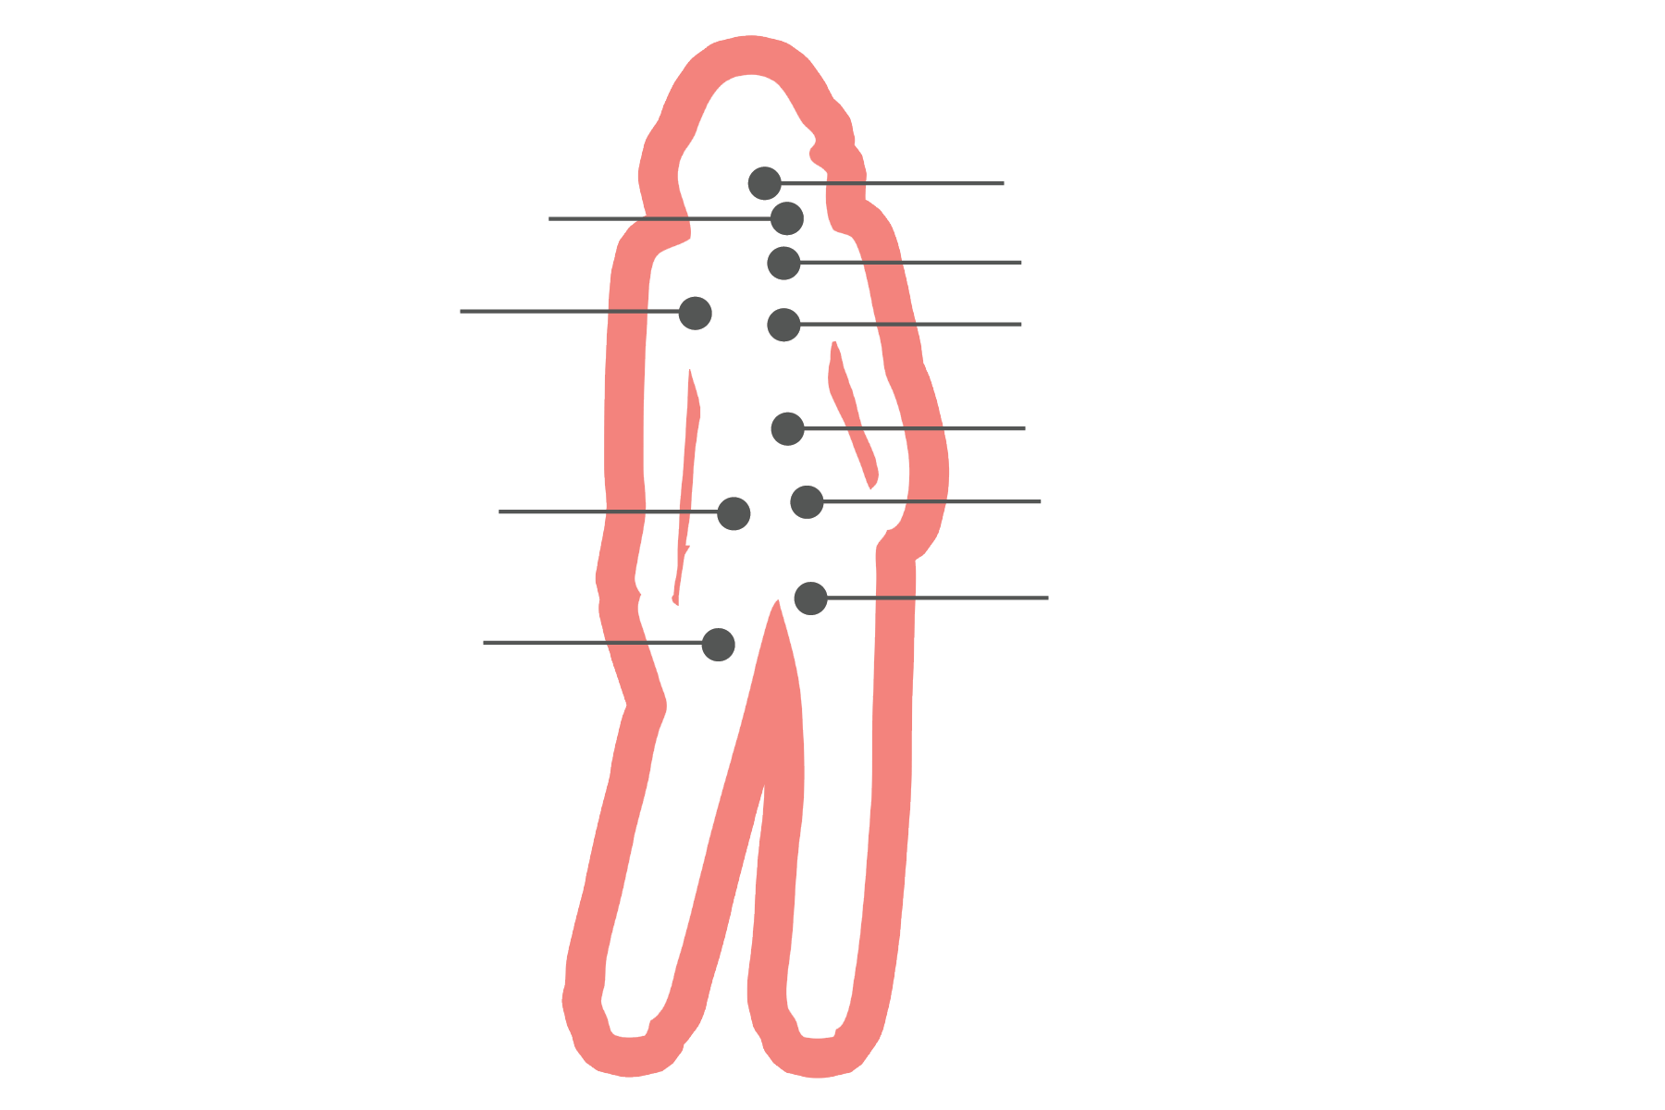
IMMUNOMODULATING
Notes:
Bihari’s work with HIV/AIDS community
Definition of Immunomodulation:
Modification of the immune response by agents that activate or suppress function
Synonym: Biologic response modifier--an agent that modified host responses to neoplasms by enhancing immune systems or reconstituting impaired immune mechanisms
Implications in Endometriosis and impact on future generations to not have endo---great in the peri=fertile years and treatment of fertility conditions, PCOS, Endo

Slide 11
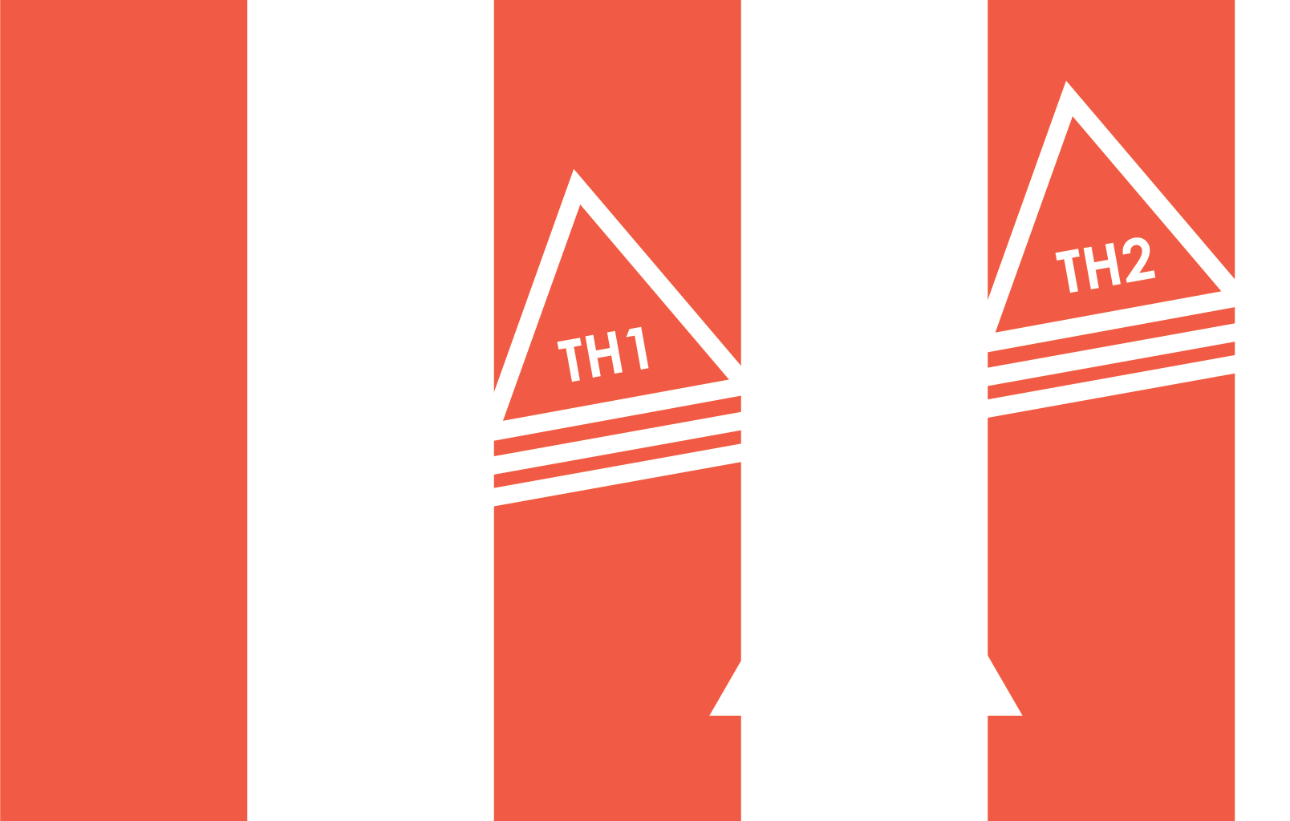
IMMUNOMODULATING
IMMUNOMODULATING
Notes:
Most of us are walking around with crazy teeter totters today (4 different patterns)
Make mention of CB1 and CB2 as well (endocannabinoid system)
M1/M2 differentiation is dependent on NOS/arginine (inhibition of healing) metabolism versus ornithing (healing)---more of a dance between the two versus a specific either or
M2 expresses high level of arginase involved in wound healing functions and high iNOS in M1
M1 dominance often inhibits healing and M2, heals
M1 and M2 are naïve to T cells so don’t invoke a TH1 or TH2 response

Slide 12
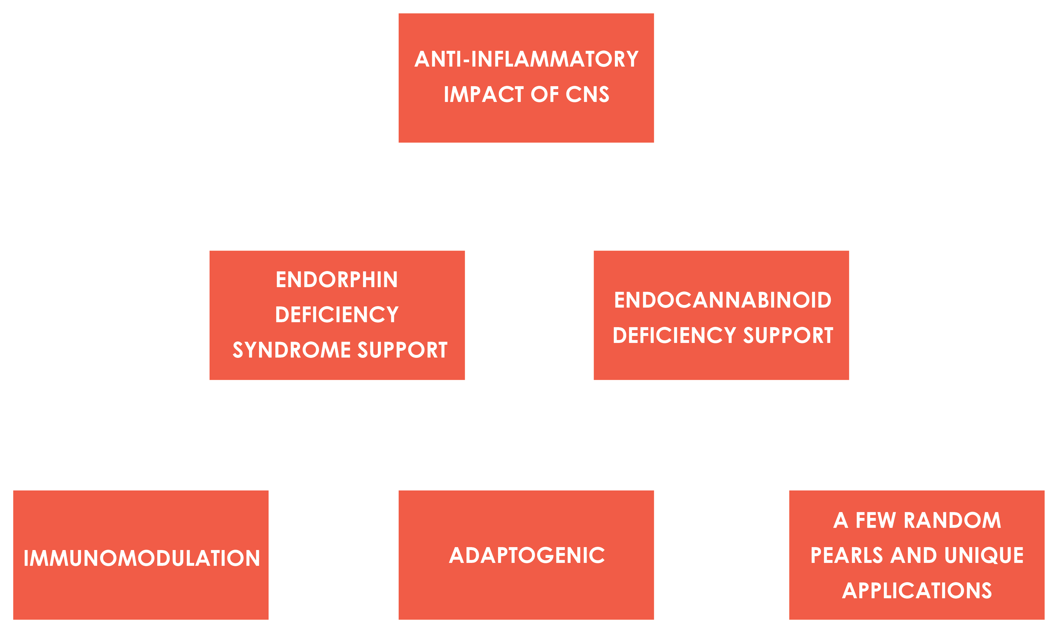
VAE & LDN
Copyright © 2018 Optimal Terrain Consulting. All Rights Reserved.
Notes:
Opiate antagonist blocks influx of endorphins in to the cell which sends signal to pituitary to release more
Naltrexone is comprised of 50:50 isomers—one binds immune cells, the other opioid receptors
Recruits T Regulatory Cells
Blocks microglia in CNS
Antagonizes Troll Like Receptor (TLR) mediated production of NF-kB lowering inflammation and downregulating oncogenes
Antagonizes TLR suppressing cytokine modulated immune system
Increases T-lymphocytes
Restores circadian rhythm
Lowers overzealous immune responses
Helps us “tolerate ourselves” and behaves like a cool compress on a sunburn to our CNS per Suzy Cohen
I love Suzy Cohen’s quote: “LDN helps you tolerate yourself”—does so by turning on the T-regulatory cells---acts like a referee on overzealous/aggressive inflammatory cytokines
And her quote: “LDN feels like a cool compress on a sunburn” when it comes to CNS inflammation☺
About 2/3 of all autoimmune patients report improvement on LDN
NOTE: high dose negates the immune effect all together
60-70% response in cancer and inhibits growth and cell proliferation, increases NK cells, induces apoptosis, antagonizes TLR
Examples of Research on LDN Impact
Pain/inflammation/swelling
IBS/IBD
CNS inflammation including ALS/myelenating diseases
Cancer studies: bladder, breast, carcinoid, CRC, GBM, liver, NSLC, leukemia and lymphoma, melanoma, myeloma, OVCA, pancreatic, prostate, RCC, Head/neck, thyroid, uterine
Parkinson’s
Autism/behavioral issues by increasing focus and stabilizing mood
QOL
PTSD
Lower histamine
Matures bone marrow and dendritic cells
Addiction/withdrawals
Stops deterioration of T-Cells in HIV/AIDS patients
Mitigates MS symptoms
Make mention of impact of QOL with both LDN and VAE as a key common theme
Discuss power of each of them individually and the synergy together based on my clinical experience and that of my mentor, Dr. Neil McKinney
Make mention of VAE book coming out that includes a chapter on adjuvant therapies with VAE, that includes LDN with more details (also KD, Cannabis)

Slide 13
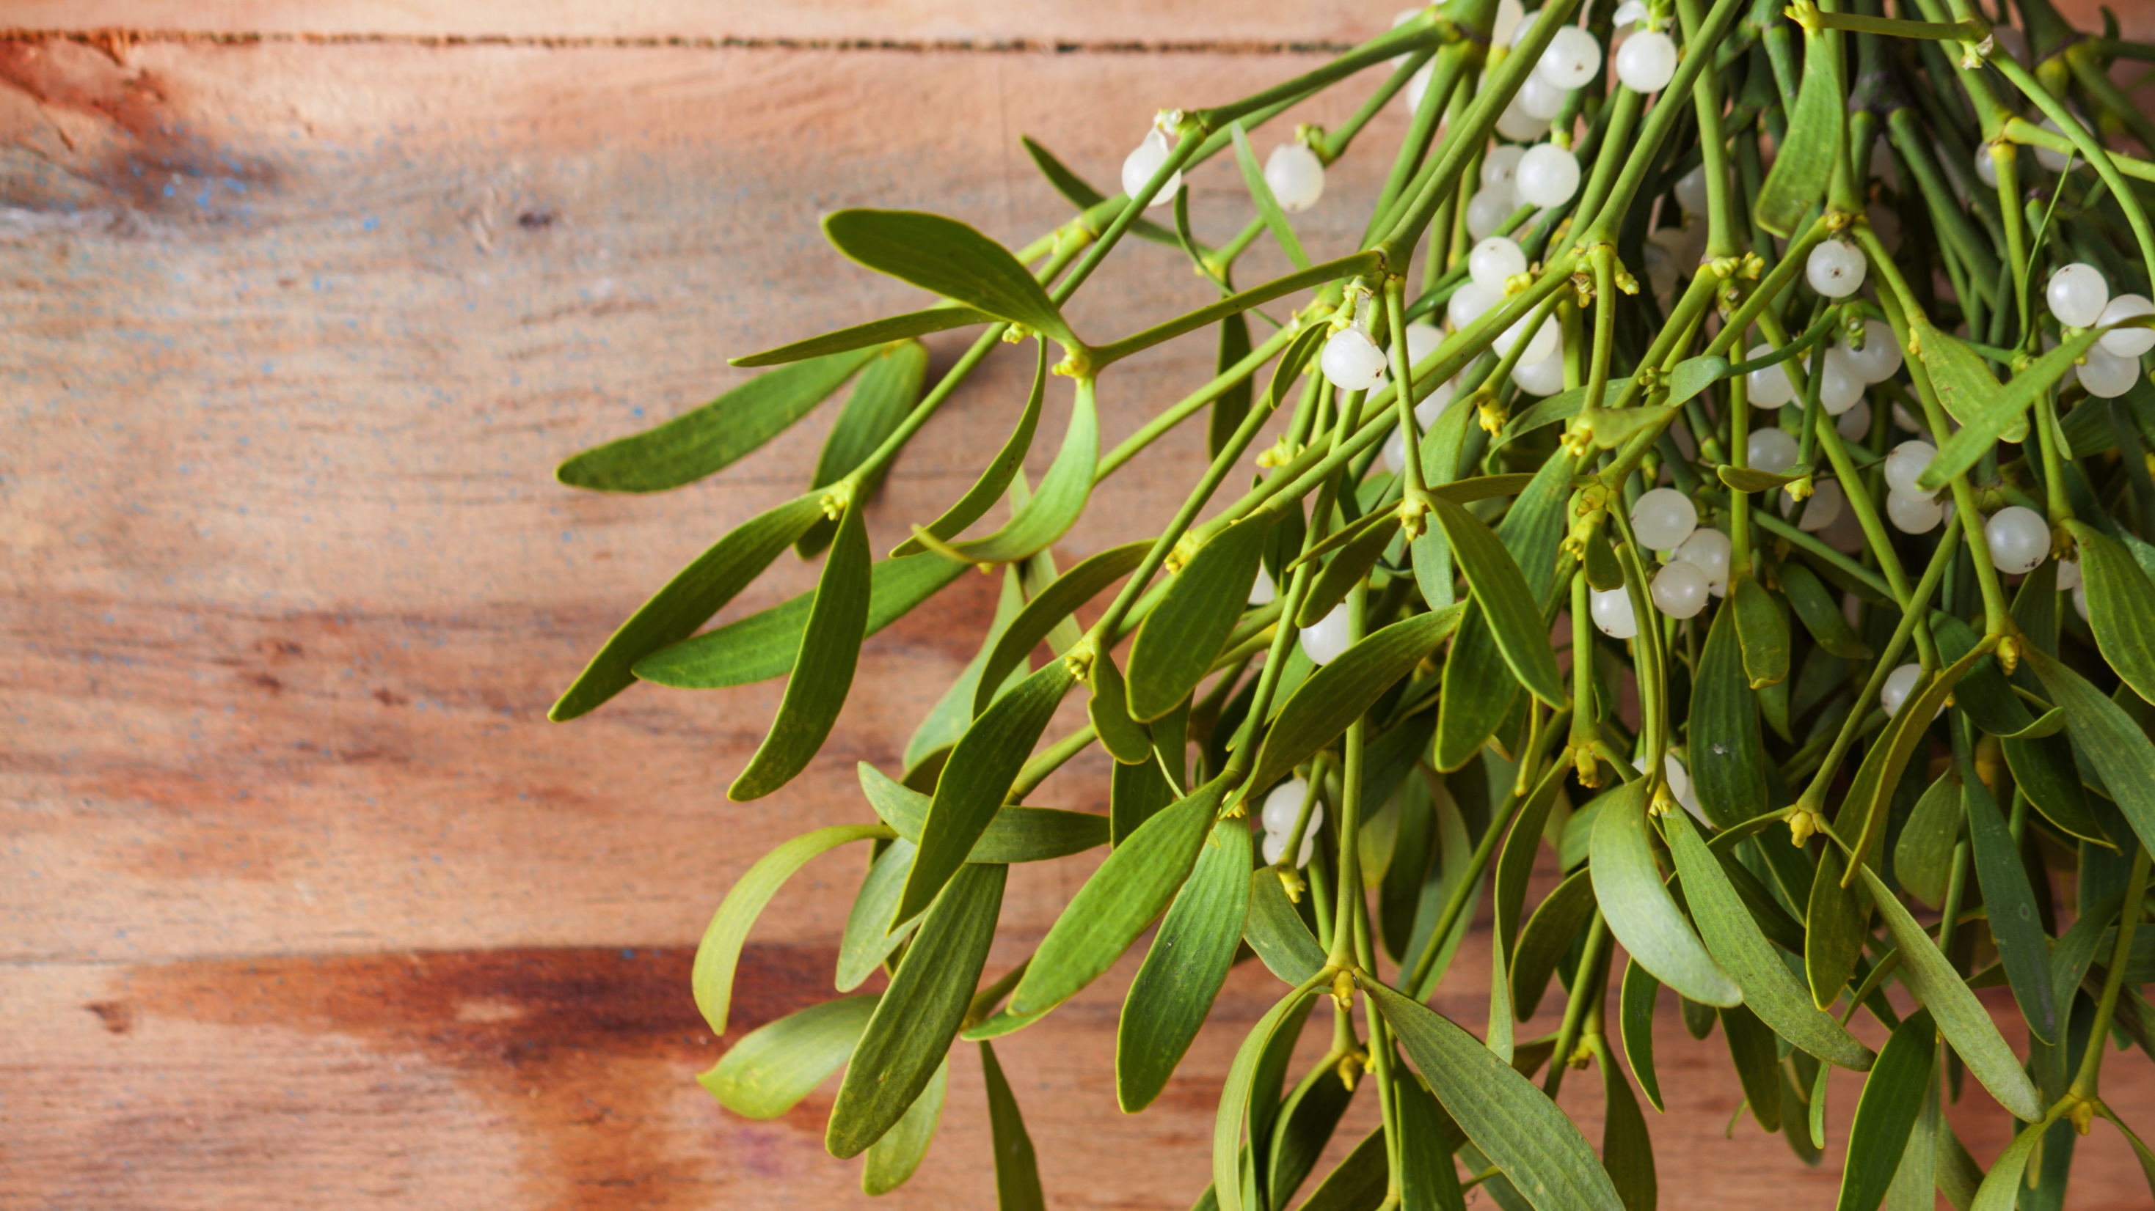
A LITTLE HISTORY
Copyright © 2018 Optimal Terrain Consulting. All Rights Reserved.
Notes:
Doctrine of Signatures
Steiner saw the parasitic plant mistletoe blooming in winter, out of rhythm with its host tree, growing towards its own centre, which reminded him of cancerous tumour behaviour.
The Mistletoe Plant
“This can become a remedy for cancer,” said Rudolf Steiner when he introduced the plant to the doctors studying with him. The gesture of the plant speaks to this. It’s unique. It’s an ancient plant, going back to prehistoric times. It is semi-parasitic; it lives off the sap of the tree in which it exists. The little balls in the tree that look like little tumors are mistletoe. It has no geo-tropism, it never touches the earth, it never ever grows on the ground, it is al- ways spherical, unlike other plants that tend to grow outwards mistletoe will grow only two leaves a year which will always start to grow back towards the center. This inward gesture of looking back towards the center is very unusual. Mistletoe is unique
because it fruits and blossoms in the winter so it doesn’t necessarily obey the normal life rhythms of nature -- it has its own in- dividuality. Mistletoe is propagated by the mistletoe thrush that eats the berries and then deposits the seeds on the trees, which then grow into the tree limbs. This type of phenomenological observation is part of the training of an Anthroposophic physician. Rudolf Steiner strongly felt that rational spiritual training of the mind could lead to powers of observation in the natural world that could add a rational perspective to sci- entific investigation.
Viscum Album is the specific plant used in Iscador therapy. The Viscum Album grows primarily in France and now is being cultivated in Switzerland and Germany. It grows particularly well on pines but there is also a variety that will grow on decidu- ous trees, especially Apple and Oak. It has a preference for certain trees and that is also unique. Viscum Album is harvested in the summer and winter and those juices are mixed together. Only plants that are extremely healthy are used. The extract is fermented, mixed together in a centrifuge by special pharmaceutical processes.
The most common mistletoe prepara- tions are Iscador, Abnoba, Helixor, Iscasen and Isorell. These preparations are sterile filtrations, put in ampules, and the quality controls are extensive. The labs meet any criteria in the world for best pharmaceuti- cal practices.
PRIMARY ACTIONS (was old slide)
VISCOTOXINS:
Cytotoxic to cell membranes & cytoskeleton
LECTINS
Modulate the Immune System
Inhibit angiogenesis
Induce Apoptosis
Inhibit ribosomes, protein synthesis
Reduce platelet aggregation,
cancer extravasation.
Palliative, improving QOL in cancer

Slide 14
Viscum
Album Extract
(Mistletoe)
White-berried European Mistletoe or Viscum album has been used successfully with cancer patients since 1917 though can be traced back to Hippocrates time to treat diseases of the spleen
Re-introduced by Dr. Ita Wegman inspired by the anthroposophical medicine teachings of Rudolf Steiner (of Waldorf and Bio-Dynamic agriculture fame) www.paam.wildapricot.org
The most studied integrative cancer therapy in the world and the most utilized (over 7000 studies)
80-85% of German and Swiss and 60-70% of the rest of European medical doctors implement mistletoe during chemo and radiation as it reduces adverse side effects such as anemia, neutropenia, thrombocytopenia, hepatic-toxicity, nausea and vomiting and also offers palliative support improving QOL, treats pain, reduces ascites and increases survival
Copyright © 2018 Optimal Terrain Consulting. All Rights Reserved.
Notes:
Helps us “tolerate ourselves” and behaves like a cool compress on a sunburn to our CNS per Suzy Cohen
I love Suzy Cohen’s quote: “LDN helps you tolerate yourself”—does so by turning on the T-regulatory cells---acts like a referee on overzealous/aggressive inflammatory cytokines
And her quote: “LDN feels like a cool compress on a sunburn” when it comes to CNS inflammation☺
About 2/3 of all autoimmune patients report improvement on LDN
NOTE: high dose negates the immune effect all together
60-70% response in cancer and inhibits growth and cell proliferation, increases NK cells, induces apoptosis, antagonizes TLR
Examples of Research on LDN Impact
Pain/inflammation/swelling
IBS/IBD
CNS inflammation including ALS/myelenating diseases
Cancer studies: bladder, breast, carcinoid, CRC, GBM, liver, NSLC, leukemia and lymphoma, melanoma, myeloma, OVCA, pancreatic, prostate, RCC, Head/neck, thyroid, uterine
Parkinson’s
Autism/behavioral issues by increasing focus and stabilizing mood
QOL
PTSD
Lower histamine
Matures bone marrow and dendritic cells
Addiction/withdrawals
Stops deterioration of T-Cells in HIV/AIDS patients
Mitigates MS symptoms
Flickman’s equation
Cells are simplest form of life---capable of independent existence and inside these cells is a gel-like mass (cytoplasm) that contains countless biological molecules and floating in this cytoplasm are organelles---discrete entities that are responsible for certain tasks and one of these organelles is the nucleus that contains the DNA
Aging is slow degeneration in the quality of the mitochondria---the process of burning up cell food using oxygen releases free radicals that can damage adjacent structures and these structures can take tens of thousands of hits daily and we are in active silent repair mode with the occasional irreversible damage that accumulate over a lifetime, reaching a threshold, causing the cell to die
Apoptosis (programmed cell death) happens when cells become damaged and worn out governed by the mitochondria and when they are too few in number and function, then they cannot induce cell death when needed which is root of cancer
They are highly adaptable to changes in energy demands and each cell that contains them, needs to respond individually and in order to do this effectively/efficiently, the mitochondria need to maintain a level of flexibility and control (lack of movement, too much movement, too much sugar, too much cortisol, etc. impacts this level of control/flexibility)
(heart and skeletal muscles require more energy so have more mitochondria along with pancreas, liver and brain).
Oocytes have 100,000 mitochondria
Sperm fewer than 100
RBCs and skin have very few, if any at all

Slide 15

MECHANISM
OF ACTION
  Mistletoe lectins are directly cytotoxic to the cancer cell membranes and cyto-skeleton and induce apoptosis
  Anti-angiogenic by lowering VEGF
  Stabilize/repairs DNA
  Inhibits ribosomes and protein synthesis (inhibits proliferation)
  impacts platelet aggregation and inhibits metastasis
  Anti-inflammatory and modulates pain response
  Immunomodulates
  Acts like a fever-inducing therapy similar to that of Coley’s toxin
  Stimulates marrow
  Enhances overall QOL including mental well-being and lifting fatigue
  Can be administered subQ, IV, intratumoral, and into abdominal ascites and into abdominal ascites and pleural effusion
Copyright © 2018 Optimal Terrain Consulting. All Rights Reserved.
Notes:
↑ leukocytes – lymphocytes, neutrophils, monos
Induces Th1
↑ CD4+ T-cells
↑ phagocytosis
↑ GM-CSF
↑ cytokines
↑↓ interleukins 4, 6, 12, 16
↑ NK cell counts and activity
↑ CD8+ cytotoxic T-cells
Activate dendritic cells

Slide 16
CASE EXAMPLES
        OVCA
        RA with NHL
        Crohn’s with CRC
        Pancreatic Cancer
        Prevention with BRCA/Lynch Mutations
        Cleaning up the mess post treatment
Copyright © 2018 Optimal Terrain Consulting. All Rights Reserved.
Notes:
↑ leukocytes – lymphocytes, neutrophils, monos
Induces Th1
↑ CD4+ T-cells
↑ phagocytosis
↑ GM-CSF
↑ cytokines
↑↓ interleukins 4, 6, 12, 16
↑ NK cell counts and activity
↑ CD8+ cytotoxic T-cells
Activate dendritic cells

Slide 17

“DO NOT GET SO TAKEN UP BY THE CANCEROUS CONDITION THAT YOU FORGET THE MOST ESSENTIAL PART OF YOUR TREATMENT---THE GENERAL CONDITION.”
–DR. ELI JONES (1920’S)
Copyright © 2018 Optimal Terrain Consulting. All Rights Reserved.

Slide 18
www.believebig.org plus PAAM and www.optimalterrainconsulting.com websites for US docs trained in use of VAE
Mansky’s study from NIH on mistletoe in 2009 and beyond: http://www.pyatthealth.com/wp-content/uploads/2015/04/Mistletoe-in-Advanced-Cancers-2.pdf
http://www.ncbi.nlm.nih.gov/pmc/articles/PMC4698621/pdf/ejh-2015-4-book.pdf
http://www.hindawi.com/journals/ecam/2014/987527/
http://thenaturedoctors.ca/wp-content/uploads/2015/01/Cochrane-Database-Review-2010.pdf
http://www.optimalterrainconsulting.com/wp-content/uploads/Helixor-Lecture-1_ICIHM_Stuttgart_11-6-2016.pdf
Graciously shared by Dr. Neil McKinney: http://www.optimalterrainconsulting.com/wp-content/uploads/MISTLETOE-references.docx
Mistletoe book co-authored by Dr. Winters and Dr. Compton and 15 other contributing authors due out Fall 2018
VAE REFERENCES
Copyright © 2018 Optimal Terrain Consulting. All Rights Reserved.
Notes:
Add PAAM and OTC websites for resources for trained antrho/VAE docs
Note: 1400+ articles on PubMed and Medline
Being the most researched plant in integrative oncology and hundreds of studies for IV application underway in Germany, Switzerland, France, Brazil and now US
2nd highest population of Anthroposophical doctors outside of Europe is Brazil (Zika!)
Combine slide 31 and 32
The Stuttgart/Helixor PDF first 8 slides are pertinent to this talk. Would like one of the images recreated.
Have Kirsten create this section…... Note: 1400+ articles on PubMed and Medline
Being the most researched plant in integrative oncology and hundreds of studies for IV application underway in Germany, Switzerland, France, Brazil and now US
2nd highest population of Anthroposophical doctors outside of Europe is Brazil (Zika!)

Slide 19



WHO ARE WE?
Nasha Winters, ND, FABNO
www.Terrain10.com/LDN
EMAIL: info@torusventures.net
BOOK: The Metabolic Approach to Cancer
Copyright © 2018 Optimal Terrain Consulting. All Rights Reserved.
We Change Cancer Outcomes.
Torus Ventures, founded by Dr. Nasha Winters and Dr. Christina Compton, is a client-driven, US-based healthcare company.
Torus uses an innovative, proprietary Terrain10™ approach to bridge the best assessment standards in conventional medicine with the best of the Terrain assessment standards in complementary medicine.
Let us be your first destination - not last - on your journey to optimal health.
We recognize people as more than a cancer diagnosis.
Notes:
Add www.torusventures.net address and drop the Lac/Diplom

